Slide 1


Information Technology Workshop
Place photo here
October 12, 2010

Slide 2
Syllabus
I. 1ntroduction to computers, identify the peripherals of a computers, components in a CPU & its functions, draw the block diagram of the CPU along with the configuration of each peripherals.
2. Disassemble & assemble the PC back to working condition [video, manual ], Hardware troubleshooting.
3. Introduction to operating system [Basics], Installation of Windows XP.
4. DOS (Internal & External ) commands, work on that commands, comparisons of windows & open source OS.

Slide 3
5. Installation of Linux O.S [Advanced debian, ubuntu], Basic Linux Commands, work on that commands.
6. Software troubleshooting, Identify the system software problems & fix it to get the computer back to working conditions.
Cyber Hygiene : Installation of Antivirus software, Configure their personal firewall & windows update on their computer, customize the browsers to block POP UPS, block active x downloads to avoid viruses and worms.
7. Introduction to Internet & LAN
Browsing the Net : Connect the LAN and access the Internet, Know how to acces the websites and email.
Search Engines:
Introduction to search engines, types of search engines, uses of search engines, how to use search engine. Give few topics to students for which they need to search on GOOGLE.

Slide 4
Introduction to Computers

Slide 5
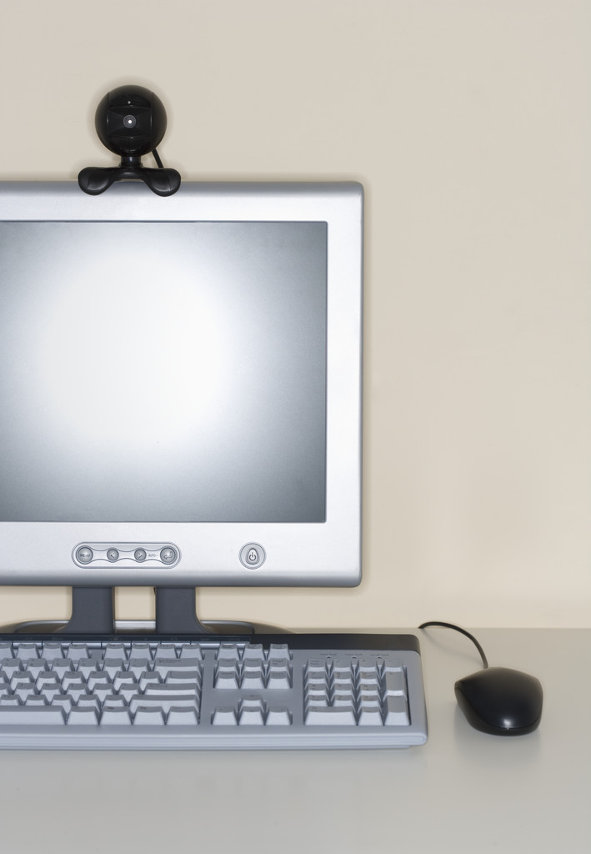
Objectives
What is a computer?
To review basic computer systems concepts
To be able to understand the different computing environments and their components

Slide 6
What is a Computer?

Slide 7

What is a Computer?
A computer is a fast electronic device that processes the input data according to instructions given by programmer/user and provides the desired information as output.

Slide 8

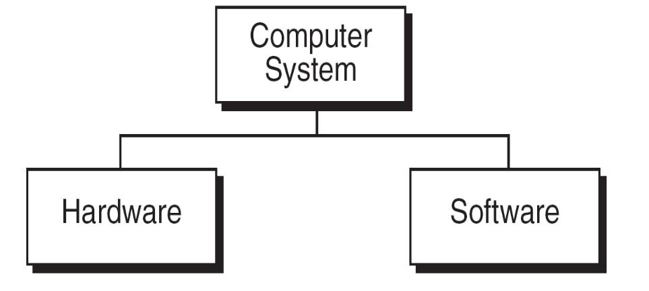
Computers Have Two Main Parts
Computer Hardware
2. Computer Software

Slide 9
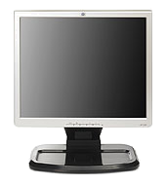
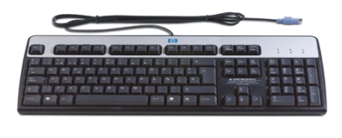



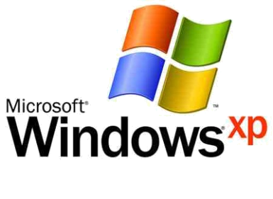
The computer and all equipment attached to it are called hardware.
The instructions that tell it what to do are called software.

Slide 10
Hardware
The hardware is the part of the computer you can touch and see.
The computer and all equipment attached to it are called hardware.

Slide 11



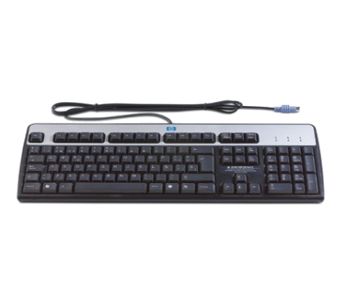
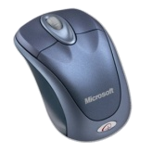

Hardware examples
The Monitor is the display screen, similar to a television screen.
The Computer, tower or case is the heart of the system. This is a box that contains all the parts that make the computer work.
The Keyboard is what you type on, similar to a typewriter.
The Mouse is the small hand held device that attaches to the computer. It may have two or three buttons. The mouse is used to move the cursor (pointer) on the computer screen.

Slide 12
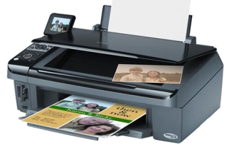
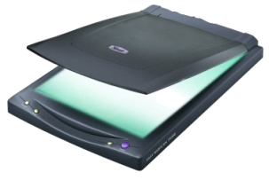
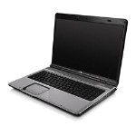
Hardware
The Printer is a device that puts what you have created on to paper.
The Scanner similar to a color photocopier is a device that captures pictures or documents, so that they can be seen or used on the computer.
The Laptop also known as a notebook computer is a small personal computer designed for mobile use.

Slide 13
Software
Software is a part of the computer you cannot touch.
The instructions that tell it what to do are called software.
Software consist of computer programs and procedures that perform some tasks on your computer.

Slide 14
Computer software is divided into three basic types
System software
Application software
Programming software

Slide 15

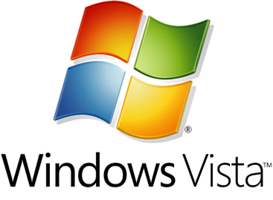
System software
  Operating System is the base program on a computer is considered system software. It tells the computer how to work or operate. The operating system also allows you to load other programs that do specialized tasks on to your computer.
  (ex. Windows XP and Vista)

Slide 16

Application software
  Application software allows you to accomplish one or more specific tasks. Such as computer games for entertainment or Microsoft Word for typing.

Slide 17

Programming software
  Programming software provides tools to assist a computer programmer in writing programs and software.

Slide 18
BASIC FUNCTIONAL UNITS OF A DIGITAL COMPUTER
A computer system has five basic functional units which are listed below
1. Input Unit
2. Output Unit
3. Control Unit
4. Memory Unit Central Processing Unit(CPU)
5. Arithmetic Logic Unit

Slide 19
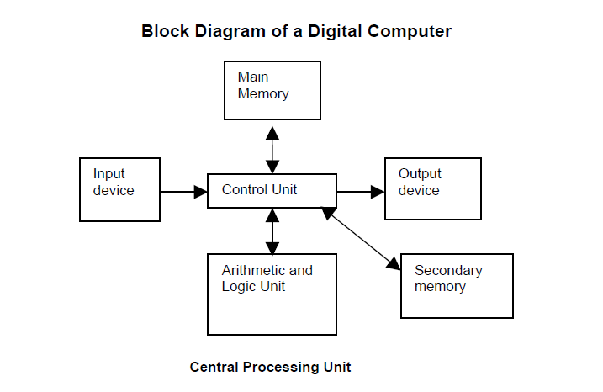

Slide 20
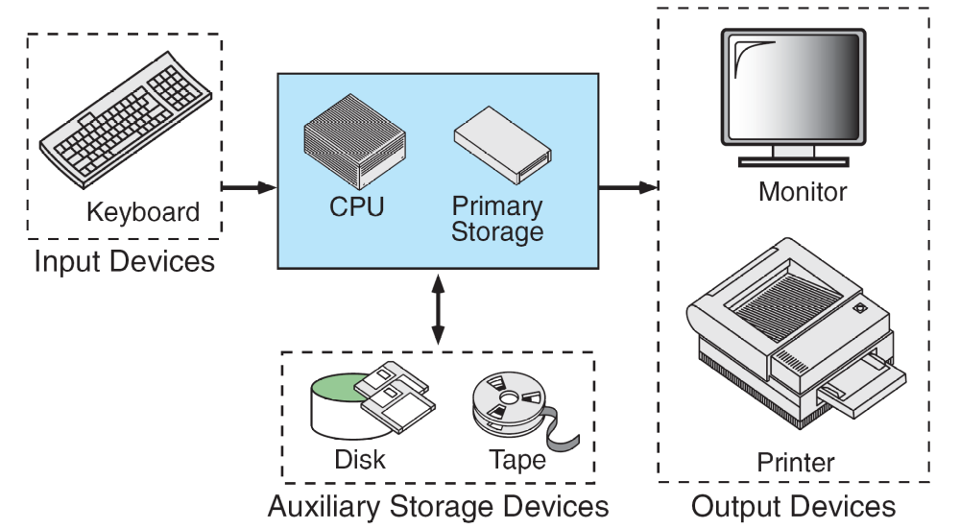
FIGURE . Basic Hardware Components

Slide 21
Central Processing Unit (CPU)
It performs all the processing of input data. The control unit and ALU of the computer are together known as the Central Processing Unit (CPU).
CPU consists of following parts:
Arithmetic Logic Unit (ALU)
2. Control Unit (CU)
3. Memory Unit (MU)
4. Registers
5. Buses
6. Clock

Slide 22
The CPU is like brain performs the following functions:
• It performs all calculations.
• It takes all decisions.
• It controls all units of the computer.

Slide 23
Memory Unit
It is used to store the data, instructions and information before, during and after the processing by ALU. It is also known as Main/Primary/Internal Memory.
It is divided into 3 types:
1. Read Only Memory (ROM)/Non-Volatile Memory
2. Random Access Memory (RAM)/ Volatile Memory
3. Complementary Metal Oxide Semiconductor Memory (CMOS)

Slide 24
Read Only Memory (ROM)/Non-Volatile Memory
ROM is permanent and is not erased when system is switched off. ROM is also called Nonvolatile Memory.
Types of ROM
1. Mask ROM
2. PROM (Programmable Read Only Memory)
3. EPROM (Erasable Programmable Read Only Memory)
4. EEPROM (Electrically Erasable Programmable Read Only Memory)
5. EAPROM (Electrically Alterable Programmable Read Only Memory)

Slide 25
Random Access Memory (RAM)/ Volatile Memory
RAM is temporary and is erased when the computer is switched off. RAM is also called volatile Memory.
Types of RAM
1. Dynamic RAM (DRAM)
2. Static RAM (SRAM)

Slide 26
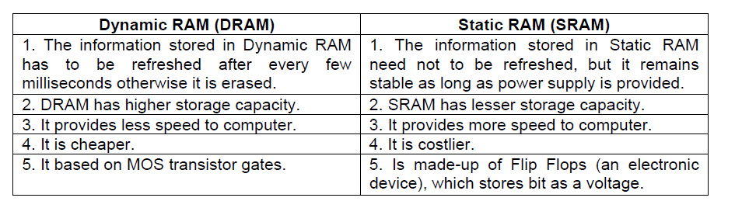
Differences between Dynamic RAM & Static RAM

Slide 27
PROGRAMMING LANGUAGES CLASSIFICATION
1. Machine Languages / First Generation Languages
2. Assembly Languages / Second Generation Languages
3. High Level Languages

Slide 28
1. Machine Languages / First Generation Languages
Each processor or CPU has its own set of instructions. These instructions are binary instructions and written in a sequence of ‘0’s and ‘1’s.
Any program written by using the binary instructions are known as machine language.
Machine language for every processor is different. Writing a program in machine language is very burden and difficult.
Advantages: The advantage of the machine language code is that a processor can execute it without any transaction.

Slide 29
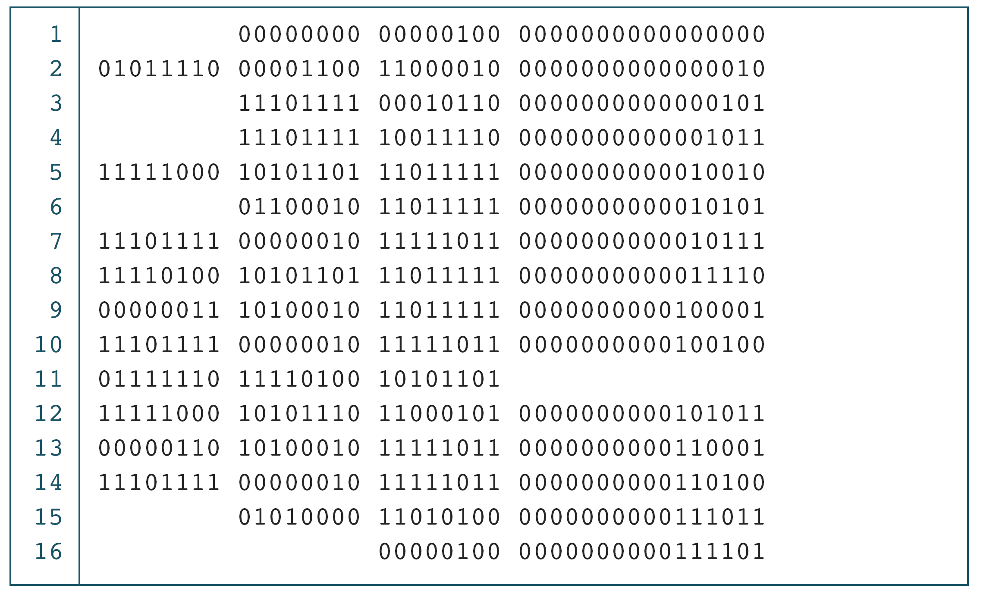
PROGRAM 1-1
The Multiplication Program in Machine Language

Slide 30
Note
The only language understood by computer
hardware is machine language.

Slide 31
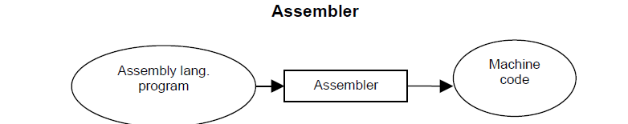
2. Assembly Language / Second Generation Languages
The processor cannot understand the code written in assembly language. So, it would not be able to execute assembly language instructions.
The processor understands the machine language. So, assembly language programs have to be converted into machine language. This is done by the assembler.
Assembler: The assembler is a program, which converts an assembly language program into machine code (object code), which can be executed by the processor.

Slide 32
Assembly language and machine language are known as lower level languages. These languages are dependent on the processor or the processor specific.
Advantages: The advantage of the assembly language over machine language is that it is more convenient for the programmer to write programs in assembly language.
.

Slide 33
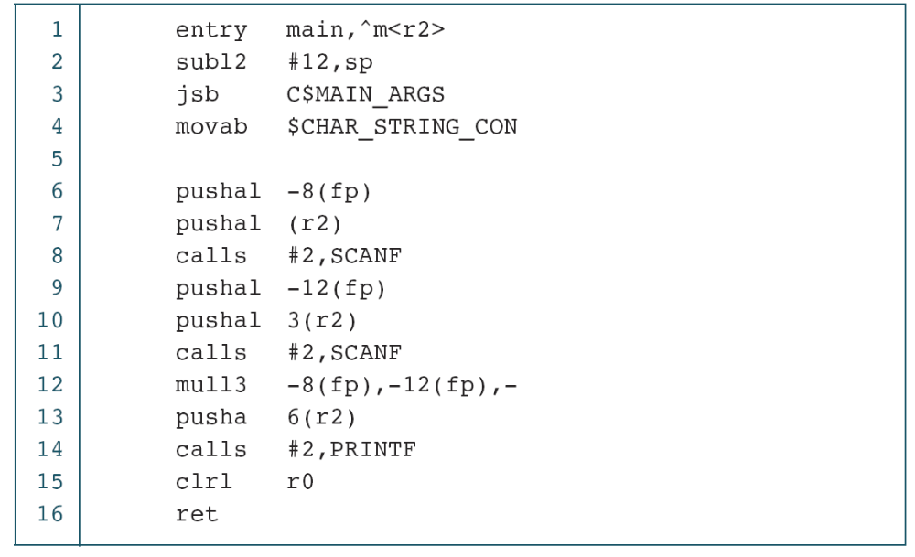
PROGRAM 1-2
The Multiplication Program in Symbolic Language

Slide 34
Note
Symbolic language uses symbols, or mnemonics, to represent the various machine language instructions.

Slide 35
3. High Level Languages (HLL)
High-level languages are machine independent. So, it is not necessary to know the architecture details of a processor to write the programs in these languages.
Ex: COBOL, BASIC, PASCAL, ADA, C etc.
Advantages: Writing programs in High Level Languages is more easy because they provide the construct and set of statements which are easy to use.
Writing a program for problem in higher-level language is easier than machine and assembly language. So, program development time in high-level language is low.

Slide 36
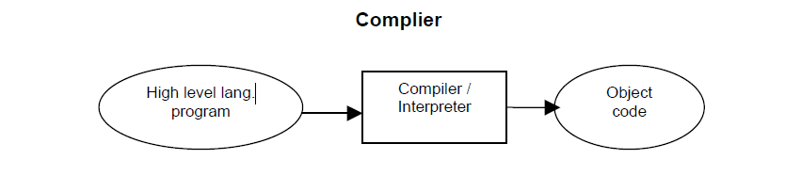
Translation of High-level language Program – Compiler/Interpreter
The program written in a high-level language needs to be translated into the language, which a machine understands. Translation of a program from high-level language to low level language is done by the software called Compiler & Interpreter.

Slide 37
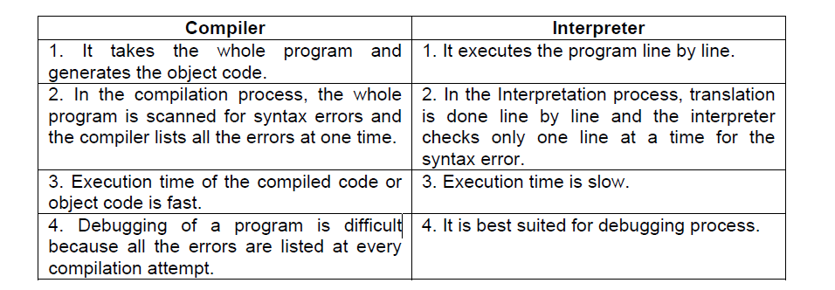
Differences between Compiler & Interpreter

Slide 38
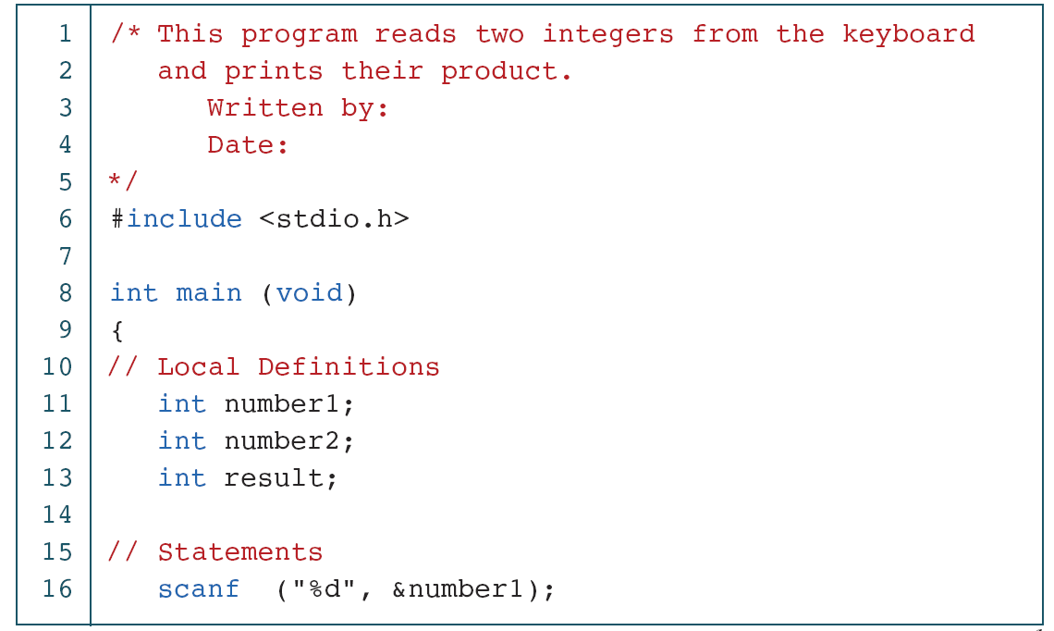
PROGRAM 1-3
The Multiplication Program in C
continued

Slide 39
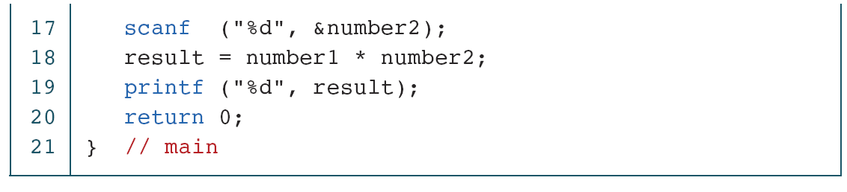
PROGRAM 1-3
The Multiplication Program in C (continued)

Slide 40
Creating and Running Programs
In this section, we explain the procedure for turning a program written in C into machine language. The process is presented in a straightforward, linear fashion, but you should recognize that these steps are repeated many times during development to correct errors and make improvements to the code.
Topics discussed in this section:
Writing and Editing Programs
Compiling Programs
Linking Programs
Executing Programs

Slide 41
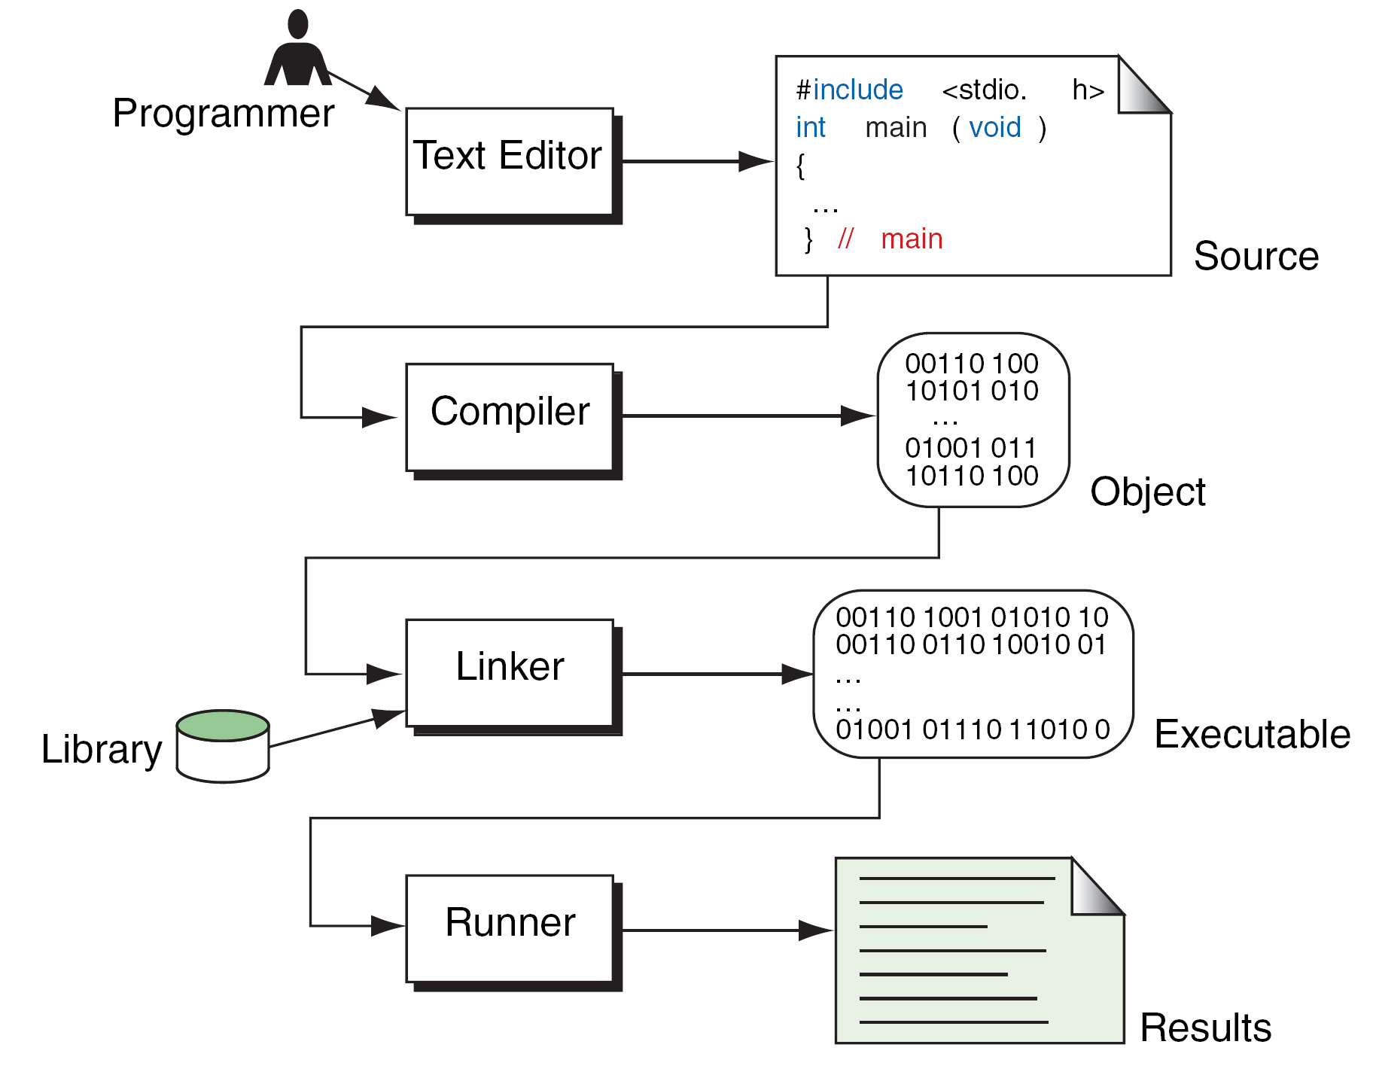
FIGURE 1-10 Building a C Program

Slide 42
I/O Devices
Input Devices: devices through which computer receives the information
    Keyboard
    Mouse
    Scanner
Output Devices: The output device is used to display or print result from a computer
    Monitor
    Printers
    Plotter

Slide 43



How to Start?

Slide 44

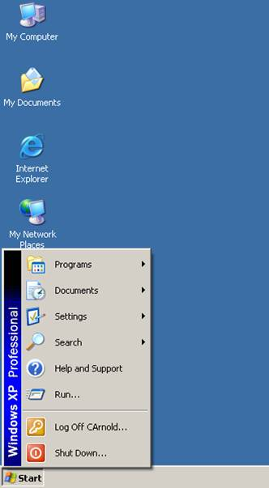



How to start?
Power Up
  Turning on your Computer
    Universal Power Symbol – most electronic devices such as computers, printers and scanners will have a button that displays this symbol. Simply, press the corresponding button to power up your computer.
  Turning off your Computer
    When powering down your computer, check to make sure all programs are closed and files are saved. Properly remove any connected devices, such as Mp3 players and USB Flash Drives.
    Click “Start” then “Shutdown” to power off your computer.

Slide 45
Operating System
  is the operating system used for this class. As an operating system Windows XP manages all that the computer does. The main screen is called the "Desktop" you can get to everything your computer can do.

Slide 46
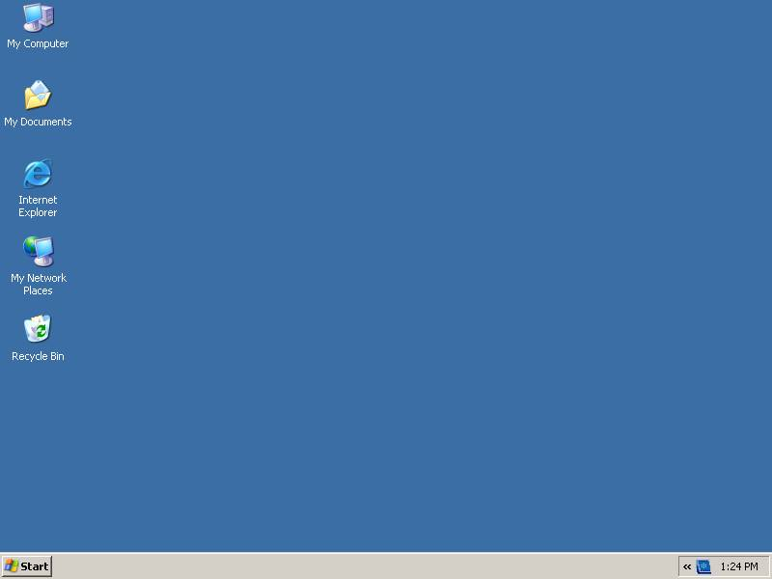
“Desktop”

Slide 47
Moving your program window.
Close -- Click on the button marked with an “x.” Clicking on this button stops the program you are using.
Maximize -- This button opens a program's window so that it fills the screen as much as it can.
Minimize -- This button puts a program on hold and places it on the taskbar at the bottom of your screen. To re-open a program that is on the taskbar click on the box which represents the program you want to open.

Slide 48
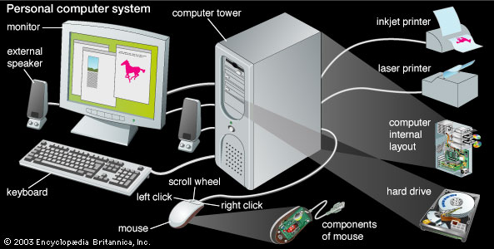
Parts of a Computer

Slide 49
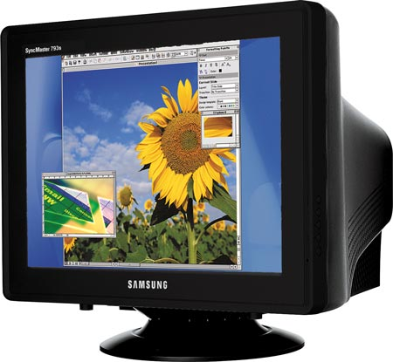
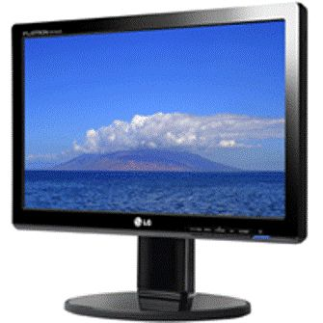
Monitor:

Slide 50
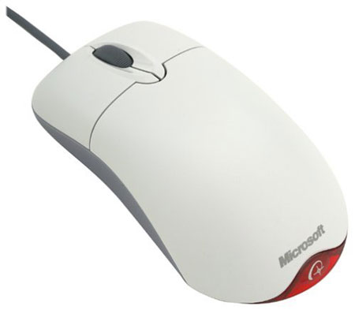
Mouse

Slide 51
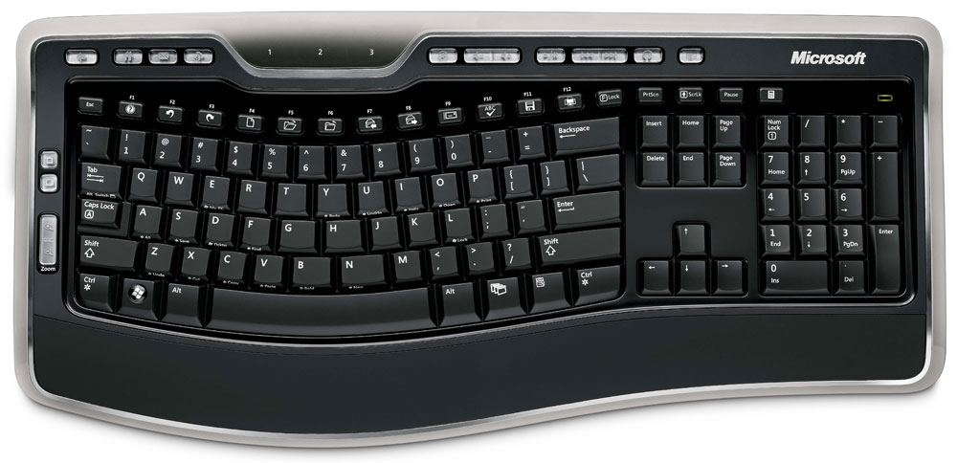
Keyboard:

Slide 52
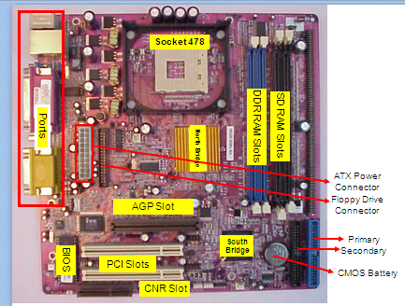
Motherboard

Slide 53
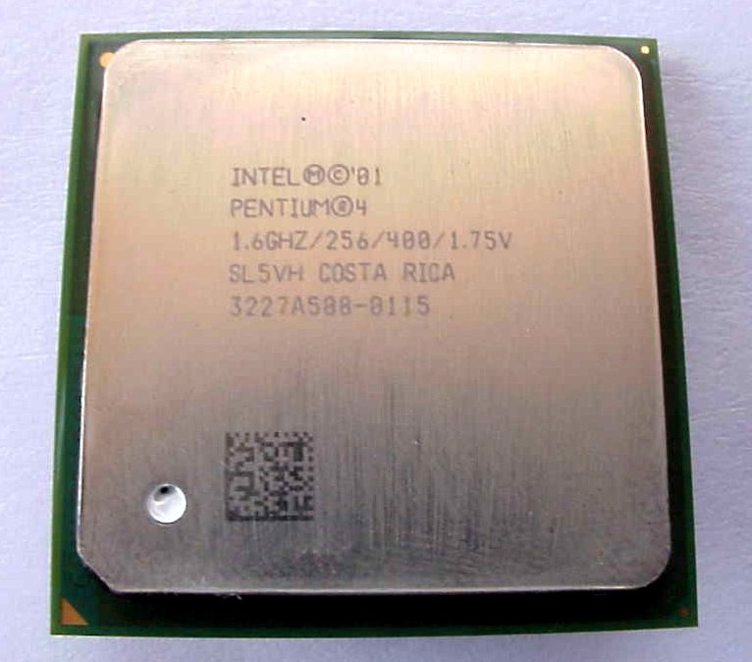
CPU

Slide 54
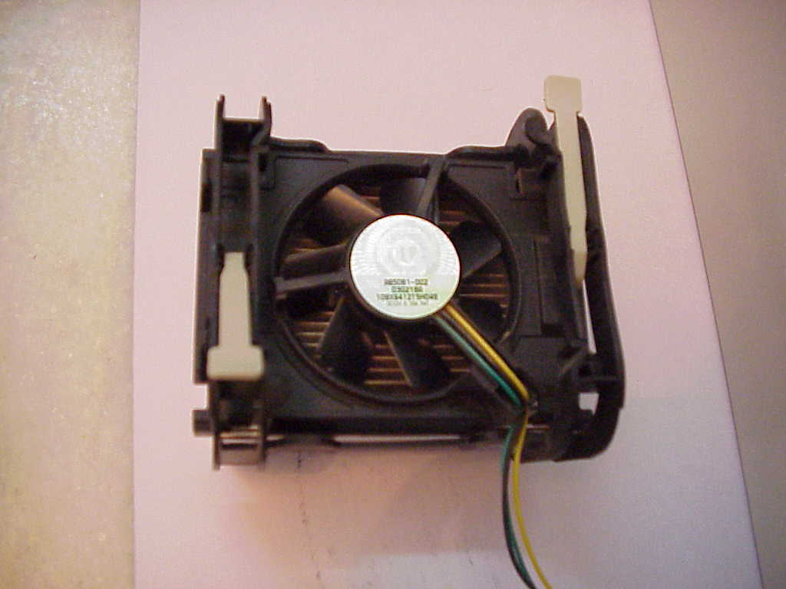
CPU Heat Sink & Fan

Slide 55
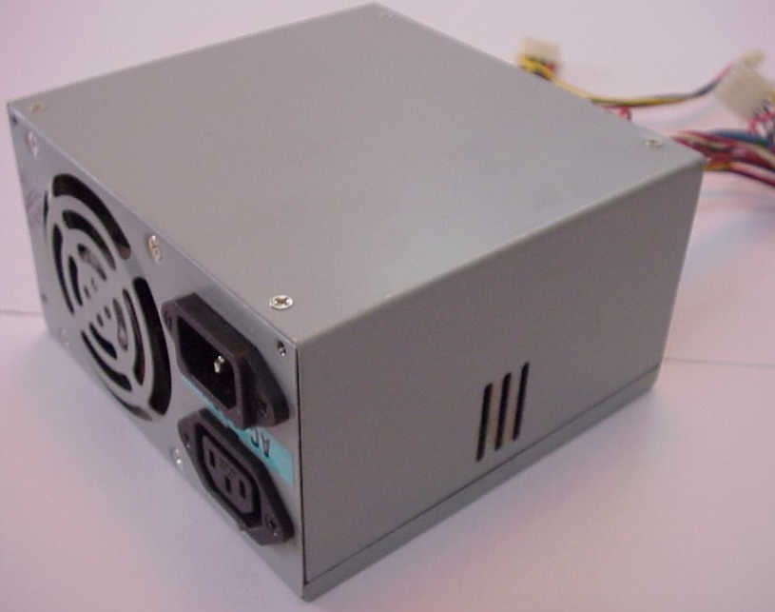
SMPS

Slide 56
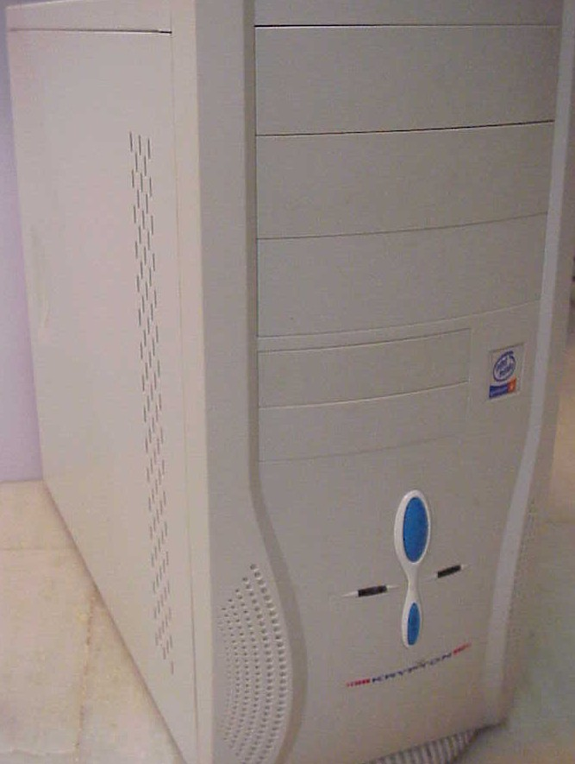

Cabinet

Slide 57
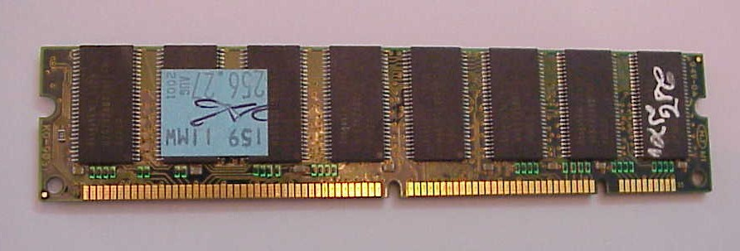
Random Access Memory
SD (Synchronous Dynamic) RAM

Slide 58
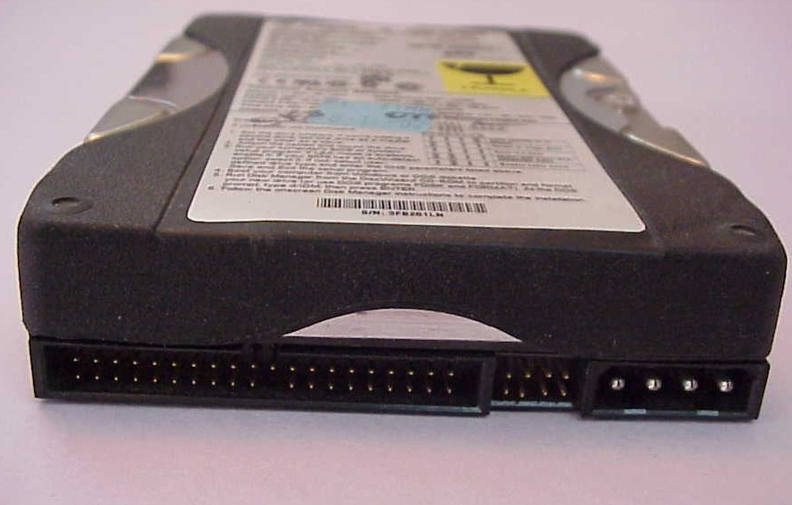
Hard Disk Drive (HDD)

Slide 59
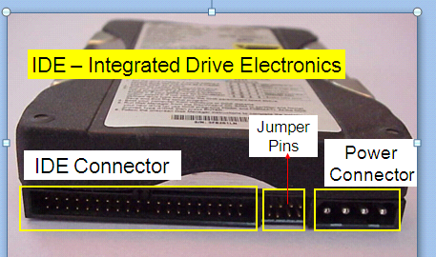
Hard Disk

Slide 60
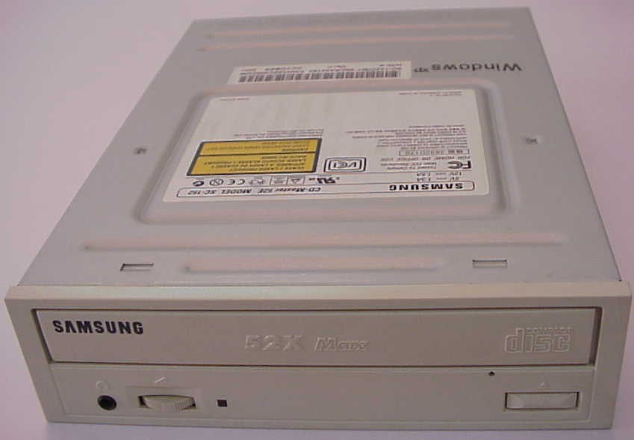
CD ROM Drive

Slide 61
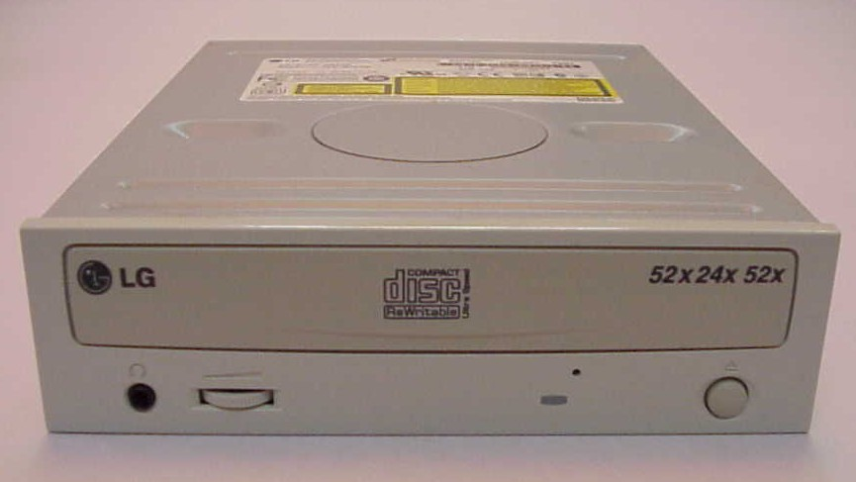
CD Writer

Slide 62
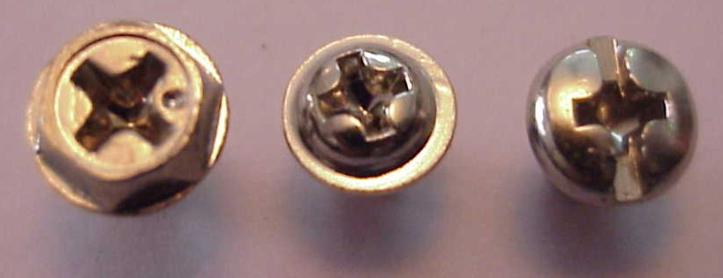
Screws

Slide 63
Place photo here
Thank You!

